Slide 1
[220] Randomness
Meena Syamkumar
Mike Doescher

Slide 2
Announcements
P13
Due Wednesday Dec 9th
No late days allowed
No resubmissions allowed (exempt: 0 score students)
Peer mentor interest form (coming soon)
Want more?
Direct follow up course: CS 320
Computer Sciences: CS 200, 300, 400
Office Hours
Last day of TA office hours Wednesday Dec 9th.
Instructor hours information – coming soon

Slide 3
Final exam
Recommended prep
make sure you understand all the worksheet problems
review the readings, slides, lecture demo code
review everything you got wrong on the midterms
review the code you wrote for the projects
prepare a note sheet (despite open material!)
Live review session on Wednesday Dec 9th
optional Q/A BBC session
attend any session

Slide 4
Course evaluations
We value student feedback greatly
Please bring a smile to your instructors' face by spending a few minutes to fill out evals ☺
CS220 SEC 001: https://aefis.wisc.edu/index.cfm/page/AefisCourseSection.home?courseSectionid=645838
CS220 SEC 002: https://aefis.wisc.edu/index.cfm/page/AefisCourseSection.home?courseSectionid=645837
CS220 SEC 003: https://aefis.wisc.edu/index.cfm/page/AefisCourseSection.home?courseSectionid=645836
CS319 SEC 001: https://aefis.wisc.edu/index.cfm/page/AefisCourseSection.home?courseSectionid=661619
CS319 SEC 002: https://aefis.wisc.edu/index.cfm/page/AefisCourseSection.home?courseSectionid=661618
CS319 SEC 003: https://aefis.wisc.edu/index.cfm/page/AefisCourseSection.home?courseSectionid=661617

Slide 5
Which series was randomly generated?
Which did I pick by hand?
1
2

Slide 6
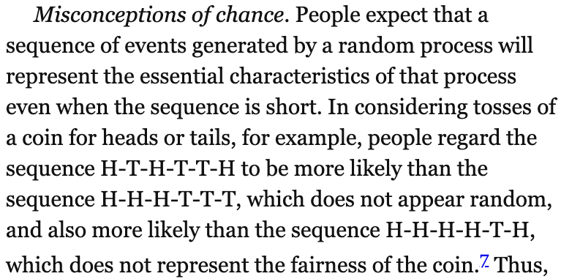
Recommended winter reading
Thinking, Fast and Slow
by Daniel Kahneman
The Signal and the Noise
by Nate Silver
The Visual Display of Quantitative Information
by Edward R. Tufte
Statistics Done Wrong
by Alex Reinhart

Slide 7
Recommended winter reading
Thinking, Fast and Slow
by Daniel Kahneman
The Signal and the Noise
by Nate Silver
The Visual Display of Quantitative Information
by Edward R. Tufte
Statistics Done Wrong
by Alex Reinhart

Slide 8
Recommended winter reading
Fluent Python: Clear, Concise,
and Effective Programming
by Luciano Ramalho
Think Python: How to Think
Like a Computer Scientist
by Allen B. Downey

Slide 9
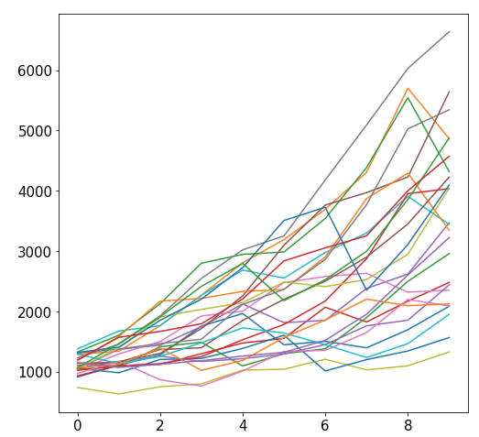
Why Randomize?
Games
Security
Simulation
our focus

Slide 10
Outline
choice()
bugs and seeding
significance
histograms
normal()

Slide 11
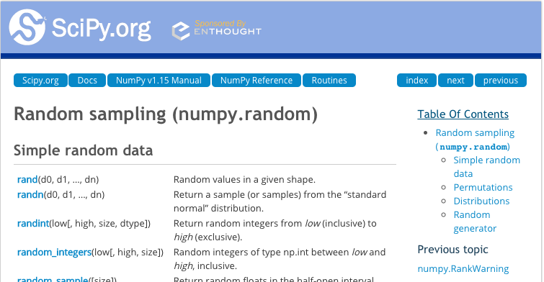
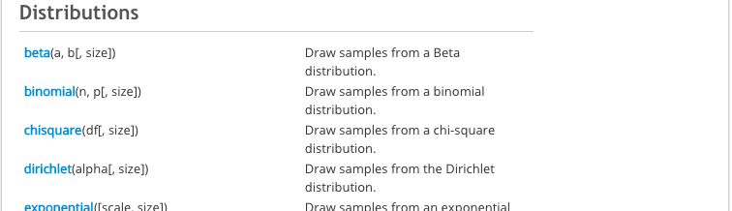
New Functions Today
numpy.random:
powerful collection of functions
Choice
Series.plot.hist:
similar to bar plot
visualize spread of random results
powerful collection of functions

Slide 12
choice
from numpy.random import choice
result = choice([<choice1, choice2, …])
list of things to
randomly choose from

Slide 13
choice
from numpy.random import choice
result = choice(["rock", "paper", "scissors"])
list of things to
randomly choose from
https://www.securifera.com/blog/2015/09/09/mmactf-2015-rock-paper-scissors-rps/

Slide 14
choice
from numpy.random import choice
result = choice(["rock", "paper", "scissors"])
print(result)
Output:
scissors
https://www.securifera.com/blog/2015/09/09/mmactf-2015-rock-paper-scissors-rps/

Slide 15
choice
from numpy.random import choice
result = choice(["rock", "paper", "scissors"])
print(result)
result = choice(["rock", "paper", "scissors"])
print(result)
Output:
scissors
rock
each time choice is
called, a value is randomly
selected (will vary run to run)

Slide 16
choice
from numpy.random import choice
choice(["rock", "paper", "scissors"], size=5)
for simulation, we'll often want
to compute many random results

Slide 17
choice
from numpy.random import choice
choice(["rock", "paper", "scissors"], size=5)
array(['rock', 'scissors', 'paper', 'rock', 'paper'], dtype='<U8')
it's list-like

Slide 18
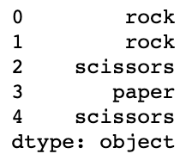
Random values and Pandas
from numpy.random import choice
# random Series
Series(choice(["rock", "paper", "scissors"], size=5))

Slide 19
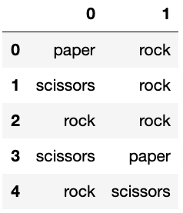
Random values and Pandas
from numpy.random import choice
# random Series
DataFrame(choice(["rock", "paper", "scissors"],
size=(5,2)))

Slide 20
Demo: exploring bias
choice(["rock", "paper", "scissors"])
Question 1: how can we make sure the randomization isn't biased?

Slide 21
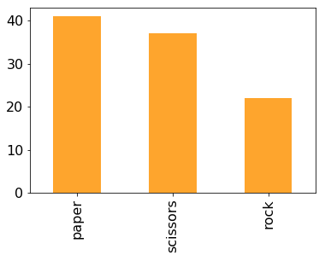
Demo: exploring bias
choice(["rock", "paper", "scissors"])
Question 1: how can we make sure the randomization isn't biased?

Slide 22
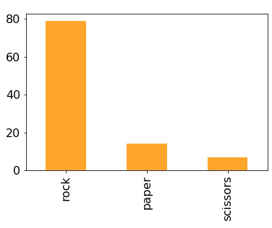
Demo: exploring bias
choice(["rock", "paper", "scissors"])
Question 1: how can we make sure the randomization isn't biased?
Question 2: how can we make it biased (if we want it to be)?
p=[...]

Slide 23
Random Strings vs. Random Ints
from numpy.random import choice, normal
# random string: rock, paper, or scissors
choice(["rock", "paper", "scissors"])
# random int: 0, 1, or 2
choice([0, 1, 2])

Slide 24
Random Strings vs. Random Ints
from numpy.random import choice, normal
# random string: rock, paper, or scissors
choice(["rock", "paper", "scissors"])
# random int: 0, 1, or 2
choice([0, 1, 2])
# random int (approach 2): 0, 1, or 2
choice(3)
same
random non-negative int
that is less than 3

Slide 25
Outline
choice()
bugs and seeding
significance
histograms
normal()

Slide 26
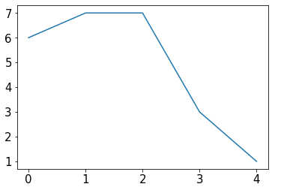
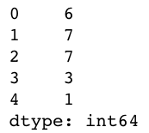
Example: change over time
s = Series(choice(10, size=5))
s.plot.line()

Slide 27
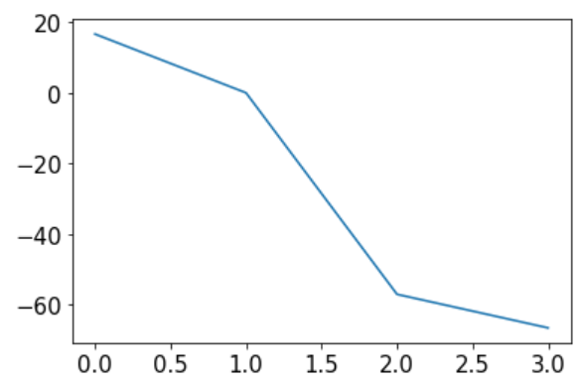
Example: change over time
s = Series(choice(10, size=5))
s.plot.line()
percents = []
for i in range(1, len(s)):
diff = 100 * (s[i] / s[i-1] - 1)
percents.append(diff)
Series(percents).plot.line()
what are we computing for diff?

Slide 28
Example: change over time
s = Series(choice(10, size=5))
s.plot.line()
percents = []
for i in range(1, len(s)):
diff = 100 * (s[i] / s[i-1] - 1)
percents.append(diff)
Series(percents).plot.line()
can you identify the bug in the code?

Slide 29
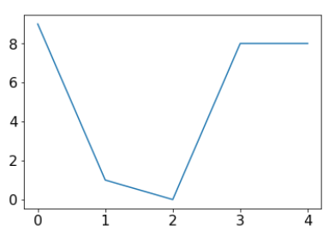
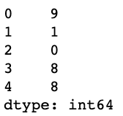
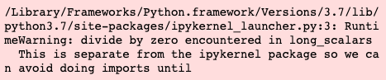
Example: change over time
s = Series(choice(10, size=5))
s.plot.line()
percents = []
for i in range(1, len(s)):
diff = 100 * (s[i] / s[i-1] - 1)
percents.append(diff)
Series(percents).plot.line()
can you identify the bug in the code?

Slide 30
Not all bugs are equal!
scary bugs
"nice" bugs
non-deterministic
deterministic (reproducible)
https://owlcation.com/stem/5-Badass-Bugs-That-You-Should-Have-Nightmares-About

Slide 31
Not all bugs are equal!
scary bugs
"nice" bugs
non-deterministic
deterministic (reproducible)
system related
randomness
https://owlcation.com/stem/5-Badass-Bugs-That-You-Should-Have-Nightmares-About

Slide 32
Not all bugs are equal!
scary bugs
"nice" bugs
non-deterministic
deterministic (reproducible)
system related
randomness
large data
small data
semantic
syntax
runtime
https://owlcation.com/stem/5-Badass-Bugs-That-You-Should-Have-Nightmares-About

Slide 33
Not all bugs are equal!
scary bugs
"nice" bugs
non-deterministic
deterministic (reproducible)
system related
randomness
large data
small data
semantic
????
syntax
runtime
https://owlcation.com/stem/5-Badass-Bugs-That-You-Should-Have-Nightmares-About

Slide 34
Not all bugs are equal!
scary bugs
"nice" bugs
non-deterministic
deterministic (reproducible)
system related
randomness
seeding
large data
small data
semantic
assert
syntax
runtime
https://owlcation.com/stem/5-Badass-Bugs-That-You-Should-Have-Nightmares-About

Slide 35
Pseudorandom Generators
"Random" generators are really just pseudorandom
684 559 629 192 835 ...
37 235 908 72 767 ...
168 527 493 584 534 ...
874 664 249 643 952 ...

Slide 36
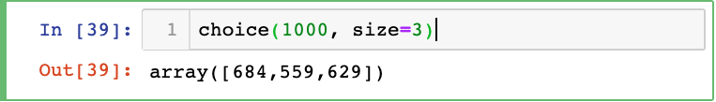
Pseudorandom Generators
"Random" generators are really just pseudorandom
684 559 629 192 835 ...
37 235 908 72 767 ...
168 527 493 584 534 ...
874 664 249 643 952 ...

Slide 37
Pseudorandom Generators
"Random" generators are really just pseudorandom
684 559 629 192 835 ...
37 235 908 72 767 ...
168 527 493 584 534 ...
874 664 249 643 952 ...

Slide 38
Pseudorandom Generators
"Random" generators are really just pseudorandom
seeds
684 559 629 192 835 ...
37 235 908 72 767 ...
168 527 493 584 534 ...
874 664 249 643 952 ...
100:
101:
102:
...:

Slide 39
Pseudorandom Generators
What if I told you that you can choose your track?
seeds
684 559 629 192 835 ...
37 235 908 72 767 ...
168 527 493 584 534 ...
874 664 249 643 952 ...
100:
101:
102:
...:

Slide 40
Seeding
What if I told you that you can choose your track?

Slide 41
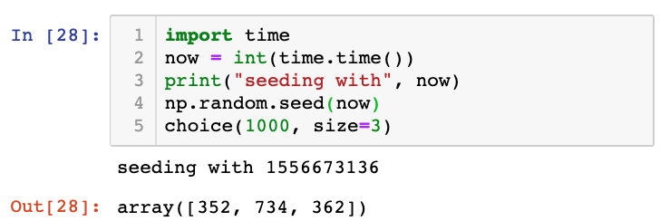
Seeding
Common approach for simulations:
seed using current time
print seed
use the seed for reproducing bugs, as necessary

Slide 42
Outline
choice()
bugs and seeding
significance
histograms
normal()

Slide 43
In a noisy world, what is noteworthy?
https://dilbert.com/strip/2001-10-25

Slide 44
Is this coin biased?
Call shenanigans?
51
49
a statistician might say we're trying to decide if the evidence that the coin isn't fair is statistically significant
whoever has the coin cheated
(it's not 50/50 heads/tails)

Slide 45
Is this coin biased?
Call shenanigans? No.
51
49

Slide 46
Is this coin biased?
Call shenanigans? No.
51
49
Call shenanigans?
5
95

Slide 47
Is this coin biased?
Call shenanigans? No.
51
49
Call shenanigans? Yes.
5
95
Note: there is a non-zero probability that a fair coin will do this, but the odds are slim

Slide 48
Is this coin biased?
Call shenanigans? No.
51
49
Call shenanigans? Yes.
5
95
Call shenanigans?
55
45
Call shenanigans?
55 million
45 million

Slide 49
Is this coin biased?
Call shenanigans? No.
51
49
Call shenanigans? Yes.
5
95
Call shenanigans? No.
55
45
Call shenanigans? Yes.
55 million
45 million

Slide 50
Is this coin biased?
Call shenanigans? No.
51
49
Call shenanigans? Yes.
5
95
large skew is good evidence of shenanigans
Call shenanigans? No.
55
45
Call shenanigans? Yes.
55 million
45 million
small skew over large samples is good evidence

Slide 51
Demo: CoinSim
Call shenanigans?
60
40
Strategy: simulate a fair coin
"flip" it 100 times using numpy.random.choice
count heads
repeat above 10K times
[50, 61, 51, 44, 39, 43, 51, 49, 49, 38, ...]

Slide 52
Demo: CoinSim
Call shenanigans?
60
40
we got 10 more heads than we expect on average
how common is this?
Strategy: simulate a fair coin
"flip" it 100 times using numpy.random.choice
count heads
repeat above 10K times
[50, 61, 51, 44, 39, 43, 51, 49, 49, 38, ...]

Slide 53
Demo: CoinSim
Call shenanigans?
60
40
we got 10 more heads than we expect on average
how common is this?
Strategy: simulate a fair coin
"flip" it 100 times using numpy.random.choice
count heads
repeat above 10K times
[50, 61, 51, 44, 39, 43, 51, 49, 49, 38, ...]
11 more
12 less

Slide 54
Outline
choice()
bugs and seeding
significance
histograms
normal()

Slide 55
Frequencies across categories
bars are a good way to view frequencies across categories
s = Series(["rock", "rock", "paper", "scissors", "scissors", "scissors"])
s.value_counts().plot.bar(color="orange")

Slide 56
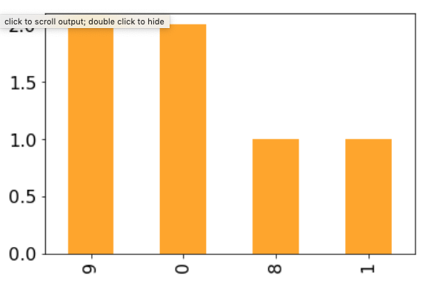
Frequencies across numbers
bars are a bad way to view frequencies across numbers
s = Series([0, 0, 1, 8, 9, 9])
s.value_counts().plot.bar(color="orange")
numbers not ordered

Slide 57
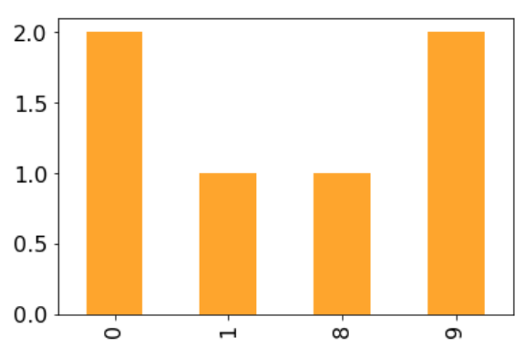
Frequencies across numbers
bars are a bad way to view frequencies across numbers
s = Series([0, 0, 1, 8, 9, 9])
s.value_counts().sort_index().plot.bar(color="orange")
gap between 1 and 8 not obvious

Slide 58
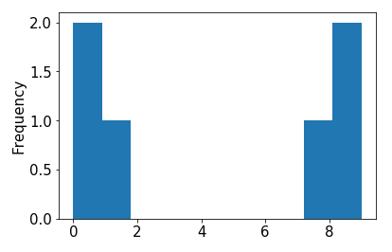
Frequencies across numbers
bars are a bad way to view frequencies across numbers
s = Series([0, 0, 1, 8, 9, 9])
s.value_counts().sort_index().plot.bar() s.plot.hist()

Slide 59
Frequencies across numbers
histograms are a good way to view frequencies across numbers
s = Series([0, 0, 1, 8, 9, 9])
s.value_counts().sort_index().plot.bar() s.plot.hist()
this kind of plot is called a histogram

Slide 60
Frequencies across numbers
histograms are a good way to view frequencies across numbers
s = Series([0.1, 0, 1, 8, 9, 9.2])
s.value_counts().sort_index().plot.bar() s.plot.hist()
both 0 and 0.1
a histogram "bins" nearby numbers to create discrete bars

Slide 61
Frequencies across numbers
histograms are a good way to view frequencies across numbers
s = Series([0.1, 0, 1, 8, 9, 9.2])
s.value_counts().sort_index().plot.bar() s.plot.hist(bins=10)
we can control the number of bins

Slide 62
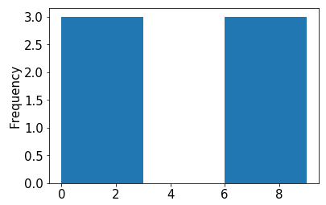
Frequencies across numbers
histograms are a good way to view frequencies across numbers
s = Series([0.1, 0, 1, 8, 9, 9.2])
s.value_counts().sort_index().plot.bar() s.plot.hist(bins=3)
too few bins provides too little detail

Slide 63
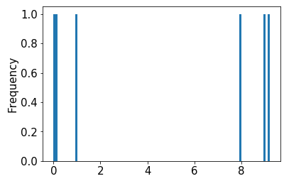
Frequencies across numbers
histograms are a good way to view frequencies across numbers
s = Series([0.1, 0, 1, 8, 9, 9.2])
s.value_counts().sort_index().plot.bar() s.plot.hist(bins=100)
too many bins provides too much detail (equally bad)

Slide 64
Frequencies across numbers
histograms are a good way to view frequencies across numbers
s = Series([0.1, 0, 1, 8, 9, 9.2])
s.value_counts().sort_index().plot.bar() s.plot.hist(bins=10)
pandas chooses the default bin boundaries

Slide 65
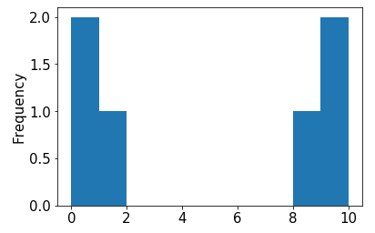
Frequencies across numbers
histograms are a good way to view frequencies across numbers
s = Series([0.1, 0, 1, 8, 9, 9.2])
s.value_counts().sort_index().plot.bar() s.plot.hist(bins=[0,1,2,3,4,5,6,7,8,9,10])
we can override the defaults

Slide 66
Frequencies across numbers
histograms are a good way to view frequencies across numbers
s = Series([0.1, 0, 1, 8, 9, 9.2])
s.value_counts().sort_index().plot.bar() s.plot.hist(bins=range(11))
this is easily done with range

Slide 67
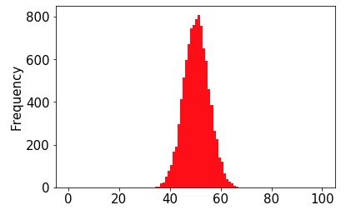
Demo: Visualize CoinSim Results
number of heads (out of 100)

Slide 68
Demo: Visualize CoinSim Results
number of heads (out of 100)
this shape resembles what we often call a normal distribution or a "bell curve"

Slide 69
Demo: Visualize CoinSim Results
number of heads (out of 100)
this shape resembles what we often call a normal distribution or a "bell curve"
in general, if we take large samples enough times, the sample averages will look like this (we won't discuss exceptions here)

Slide 70
Demo: Visualize CoinSim Results
number of heads (out of 100)
numpy can directly
generate random
numbers fitting a
normal distribution
this shape resembles what we often call a normal distribution or a "bell curve"
in general, if we take large samples enough times, the sample averages will look like this (we won't discuss exceptions here)

Slide 71
Outline
choice()
bugs and seeding
significance
histograms
normal()

Slide 72
normal
from numpy.random import choice, normal
import numpy as np
for i in range(10):
print(normal())

Slide 73
normal
from numpy.random import choice, normal
import numpy as np
for i in range(10):
print(normal())
Output:
-0.18638553993371157
0.02888452916769247
1.2474561113726423
-0.5388224399358179
-0.45143322136388525
-1.4001861112018241
0.28119371511868047
0.2608861898556597
-0.19246288728955144
0.2979572961710292
average is 0 (over many calls)
numbers closer to 0 more likely
-x just as likely as x

Slide 74
normal
from numpy.random import choice, normal
import numpy as np
s = Series(normal(size=10000))

Slide 75
normal
from numpy.random import choice, normal
import numpy as np
s = Series(normal(size=10000))
s.plot.hist()

Slide 76
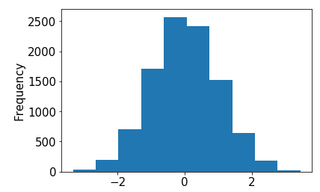
normal
from numpy.random import choice, normal
import numpy as np
s = Series(normal(size=10000))
s.plot.hist()

Slide 77
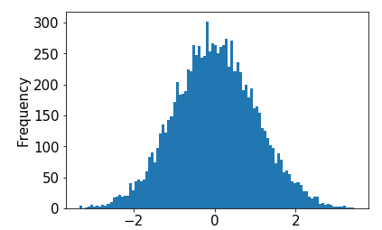
normal
from numpy.random import choice, normal
import numpy as np
s = Series(normal(size=10000))
s.plot.hist(bins=100)

Slide 78
normal
from numpy.random import choice, normal
import numpy as np
s = Series(normal(size=10000))
s.plot.hist(bins=100, loc= , scale= )

Slide 79
normal
from numpy.random import choice, normal
import numpy as np
s = Series(normal(size=10000))
s.plot.hist(bins=100, loc= , scale= )
try plugging in different values
(defaults are 0 and 1, respectively)

Slide 80
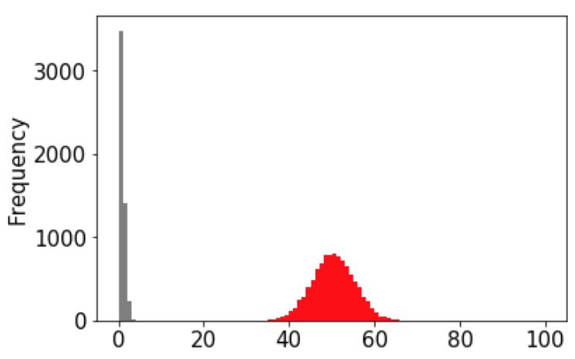
Demo: plot overlay
10K samples of 100 coin flips
10K samples from normal(size=10000)

Slide 81
Demo: plot overlay
version 1
10K samples of 100 coin flips
10K samples from normal(size=10000)
goal: play with loc and scale arguments to normal until gray overlaps red

Slide 82
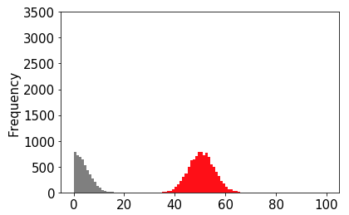
Demo: plot overlay
version 2
10K samples of 100 coin flips
10K samples from normal(size=10000)
goal: play with loc and scale arguments to normal until gray overlaps red

Slide 83
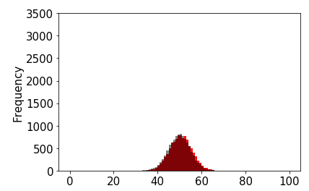
Demo: plot overlay
version 3
10K samples of 100 coin flips
10K samples from normal(size=10000)
goal: play with loc and scale arguments to normal until gray overlaps red

